Slide 1


Lecture 14: Visualization
A vehicle for EDA and communication
Harvard IACS
CS109A
Pavlos Protopapas, Kevin Rader, and Chris Tanner

Slide 2
As the matplotlib thickens …

Slide 3
ANNOUNCEMENTS
Homework 3 is due Oct 7 (Wed) @ 11:59pm
Didn’t submit Milestone 1? Want to change project selection? E-mail the helpline at cs109a2020@gmail.com
After lecture, please update your Zoom to the latest version (5.3.1).

Slide 4
Learning Objectives
Understand why visualization/plotting is important
Learn aspects that tend to make visualizes effective and ineffective
Feel comfortable designing plots that best convey your message
Gain experience in producing plots with Python
be more cognizant of broader design choices (e.g., typography, spacing, colors)
Extra Goal

Slide 5
Agenda
EDA Refresher
Effective Visualization
Graphical Integrity
Scope
Displays
Sensible Design
Communication
Motivation
Key Considerations

Slide 6
Agenda
EDA Refresher
Effective Visualization
Graphical Integrity
Scope
Displays
Sensible Design
Communication
Motivation
Key Considerations

Slide 7
Assume you know a given dataset is credible, complete with the info you want, and has no missing values.
Why do further EDA?

Slide 8
Purposes of EDA:
Maximize insight into a dataset
Uncover underlying structure
Detect outliers
Test underlying assumptions
Develop parsimonious models

Slide 9
EDA Refresher: English Premier League
name
club
age
position
market value
Alexis Sanchez
Arsenal
28
LW
65
Mesut Ozil
Arsenal
28
AM
50
Petr Cech
Arsenal
35
GK
7
Theo Walcott
Arsenal
28
RW
20
Laurent Koscielny
Arsenal
31
CB
22
from www.transfermarkt.us

Slide 10
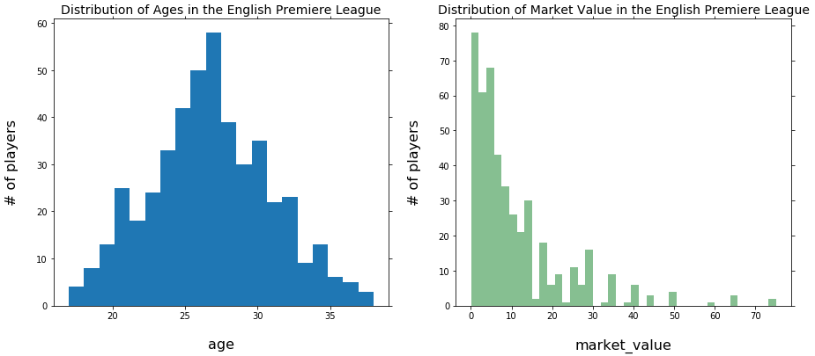
EDA Refresher: English Premier League

Slide 11
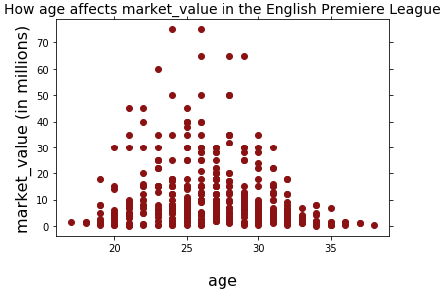
EDA Refresher: English Premier League

Slide 12
EDA Refresher: English Premier League
Are the outliers legit?

Slide 13
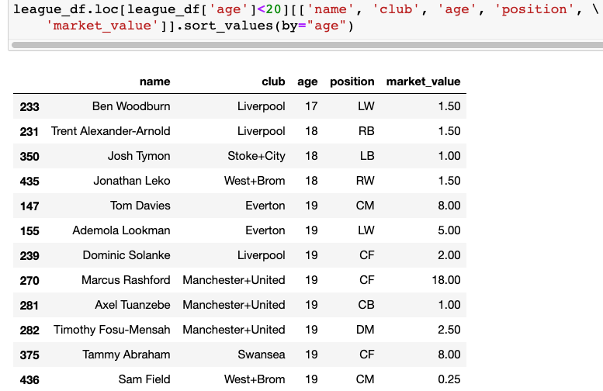
EDA Refresher: English Premier League

Slide 14
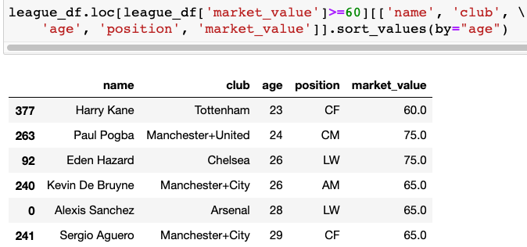
EDA Refresher: English Premier League

Slide 15
EDA Refresher: English Premier League

Slide 16
Agenda
EDA Refresher
Effective Visualization
Graphical Integrity
Scope
Displays
Sensible Design
Communication
Motivation
Key Considerations
DISCLAIMER.
Some of these examples involve political data. In no way should this be taken as a signal of my support or endorsement in any beliefs; the point is merely to convey good and bad choices when it comes to effective visualization.

Slide 17
Agenda
EDA Refresher
Effective Visualization
Graphical Integrity
Scope
Displays
Sensible Design
Communication
Motivation
Key Considerations
DISCLAIMER.
Some of these examples involve political data. In no way should this be taken as a signal of my support or endorsement in any beliefs; the point is merely to convey good and bad choices when it comes to effective visualization.

Slide 18
Agenda
EDA Refresher
Effective Visualization
Graphical Integrity
Scope
Displays
Sensible Design
Communication
Motivation
Key Considerations
DISCLAIMER.
Some of these examples involve political data. In no way should this be taken as a signal of my support or endorsement in any beliefs; the point is merely to convey good and bad choices when it comes to effective visualization.

Slide 19
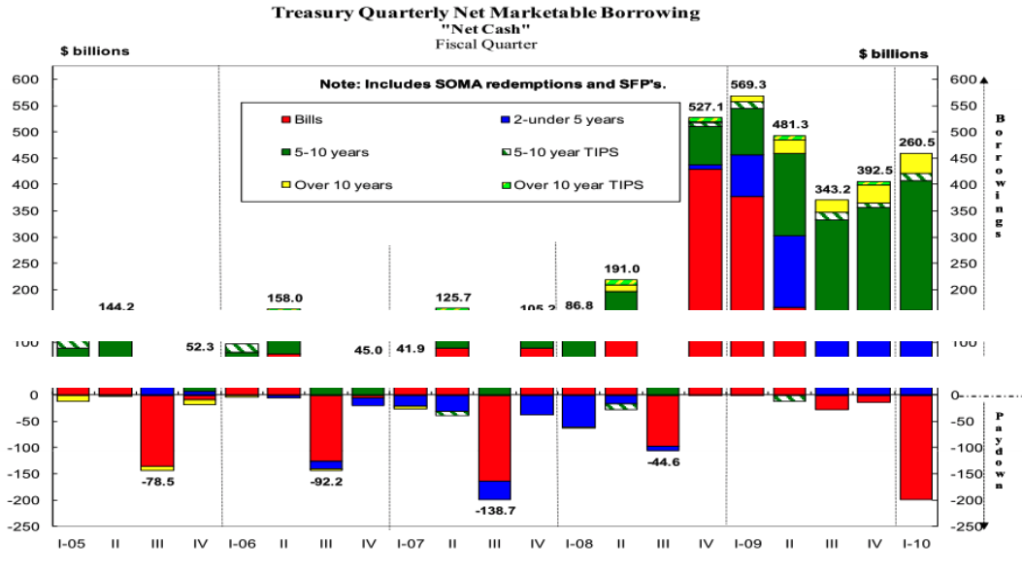
Ineffective Visualization

Slide 20
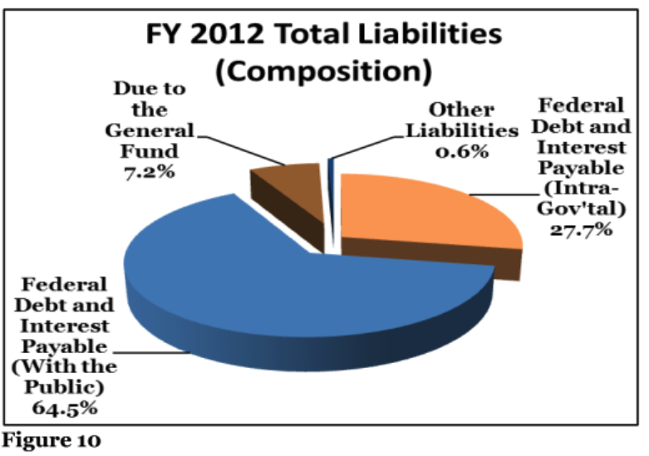
Ineffective Visualization

Slide 21
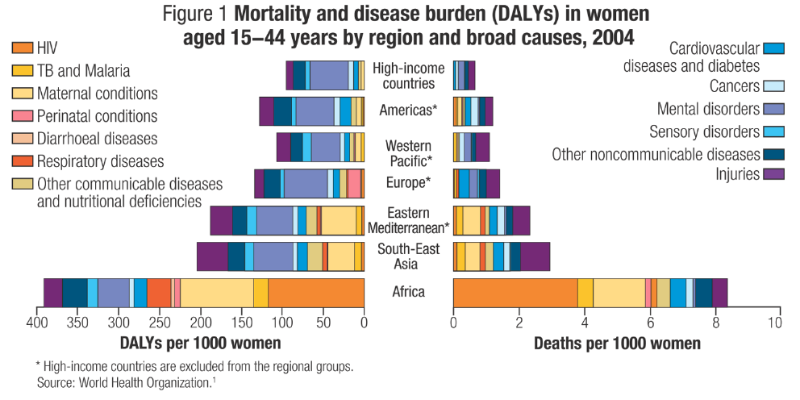
Ineffective Visualization

Slide 22
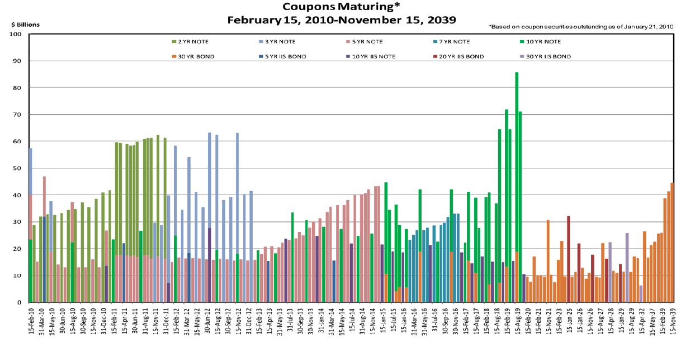
Ineffective Visualization

Slide 23
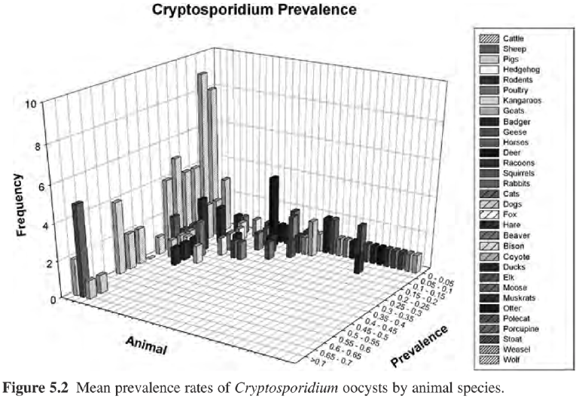
Ineffective Visualization

Slide 24
Agenda
EDA Refresher
Effective Visualization
Graphical Integrity
Scope
Displays
Sensible Design
Communication
Motivation
Key Considerations

Slide 25
Agenda
EDA Refresher
Effective Visualization
Graphical Integrity
Scope
Displays
Sensible Design
Communication
Motivation
Key Considerations

Slide 26
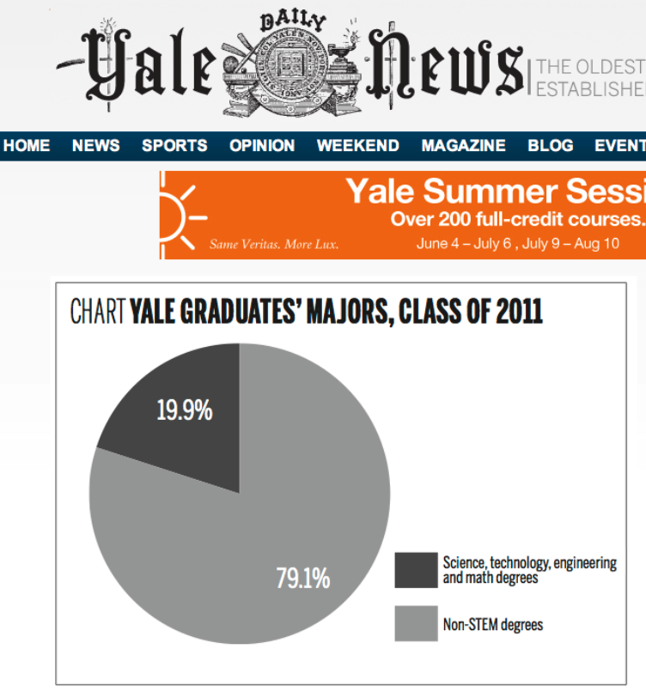
Graphical Integrity: What’s wrong?

Slide 27
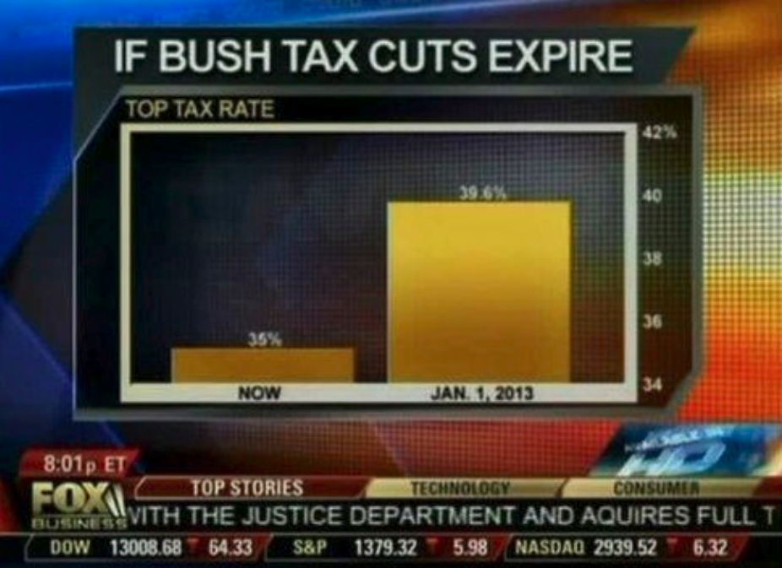
Graphical Integrity: What’s wrong?

Slide 28
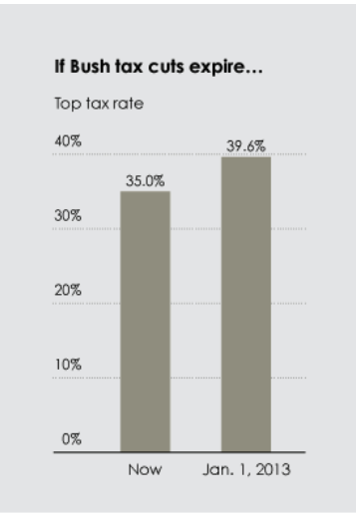
Graphical Integrity: What’s wrong? Real Story
What’s wrong?

Slide 29
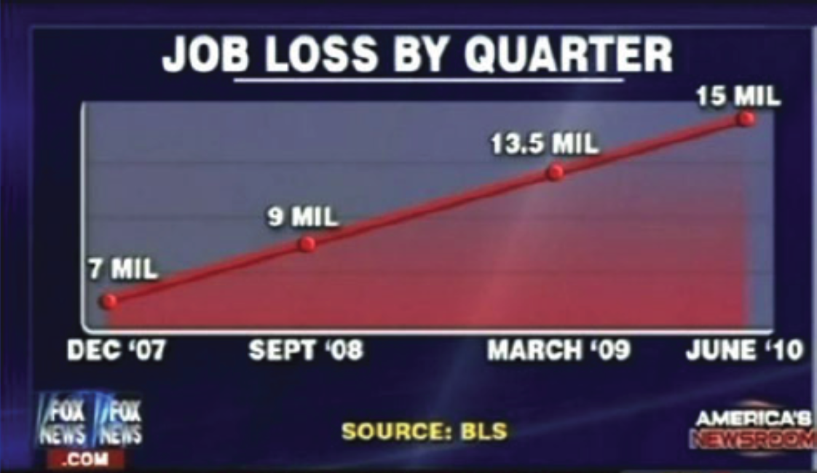
Graphical Integrity: What’s wrong?

Slide 30
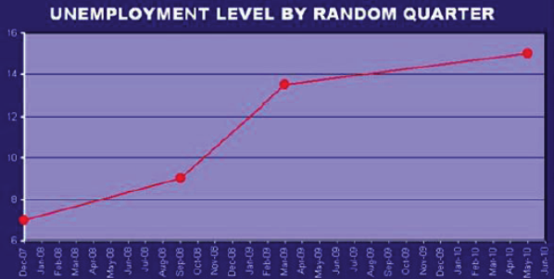
Graphical Integrity: What’s wrong? Real Story
What’s wrong?

Slide 31
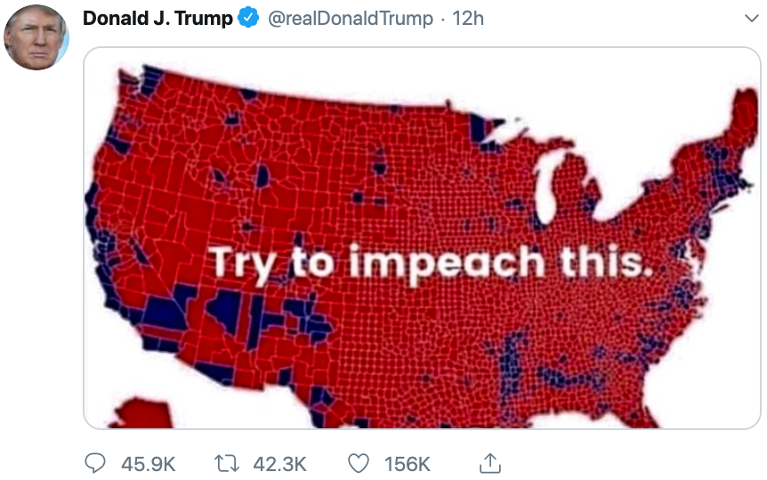
Graphical Integrity: What’s wrong?
October 1, 2019

Slide 32
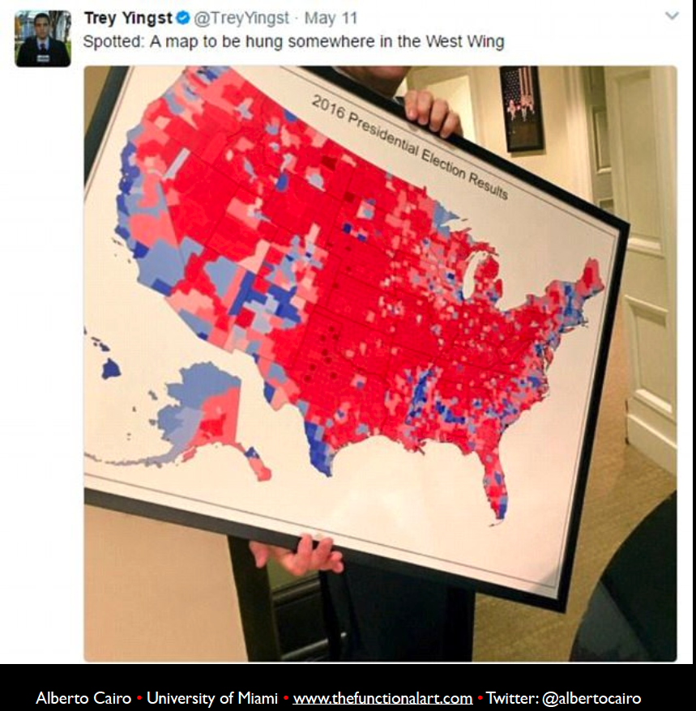
Graphical Integrity: What’s wrong?

Slide 33
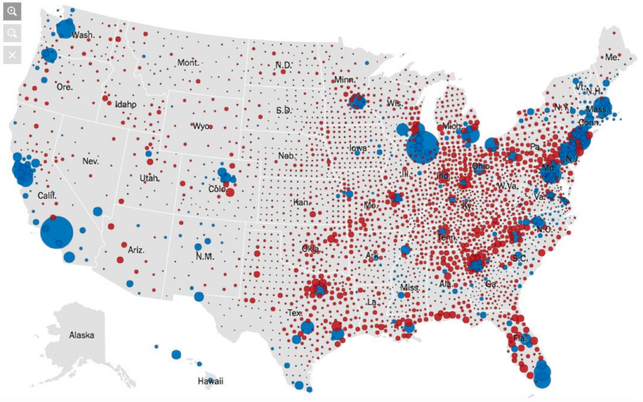
Graphical Integrity: What’s wrong?

Slide 34
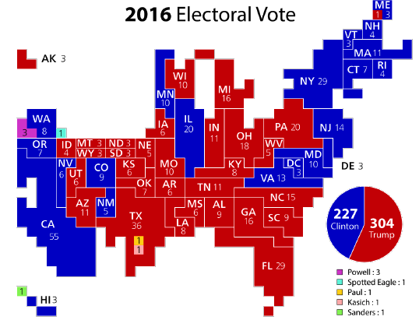
Graphical Integrity: What’s wrong? Real Story

Slide 35
Graphical Integrity: What’s wrong?
Lesson: be proportional

Slide 36
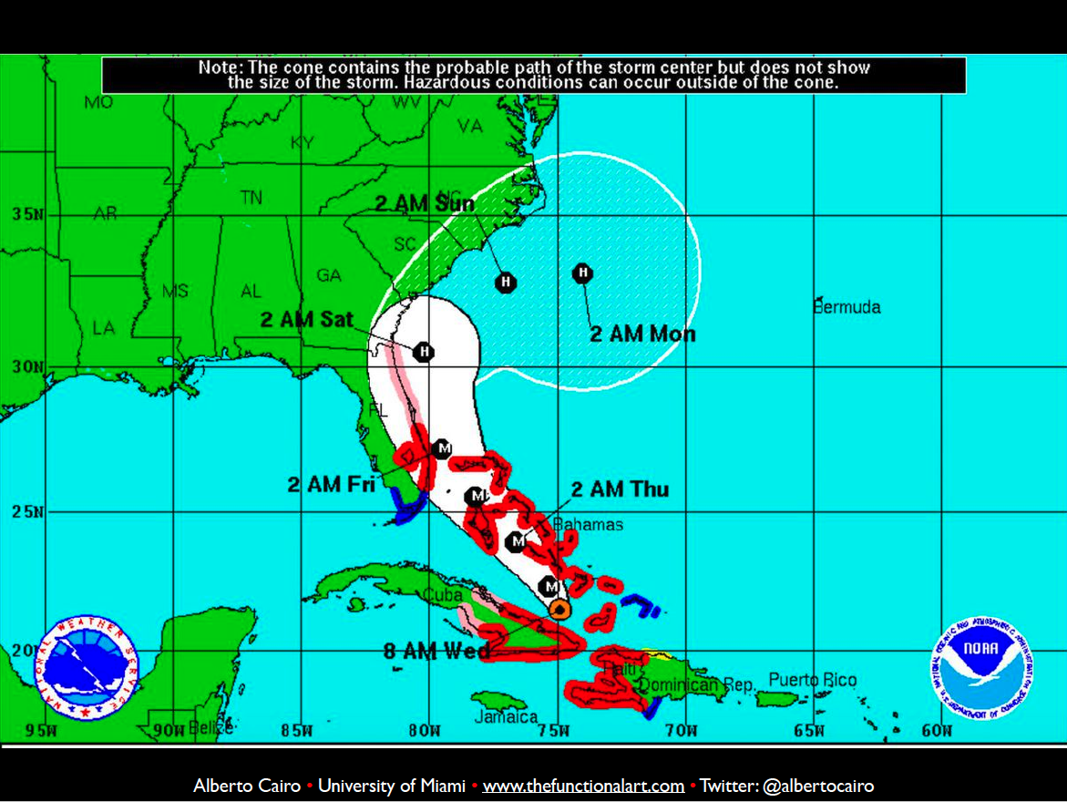
Graphical Integrity: What’s wrong?

Slide 37

Graphical Integrity: What’s wrong?

Slide 38
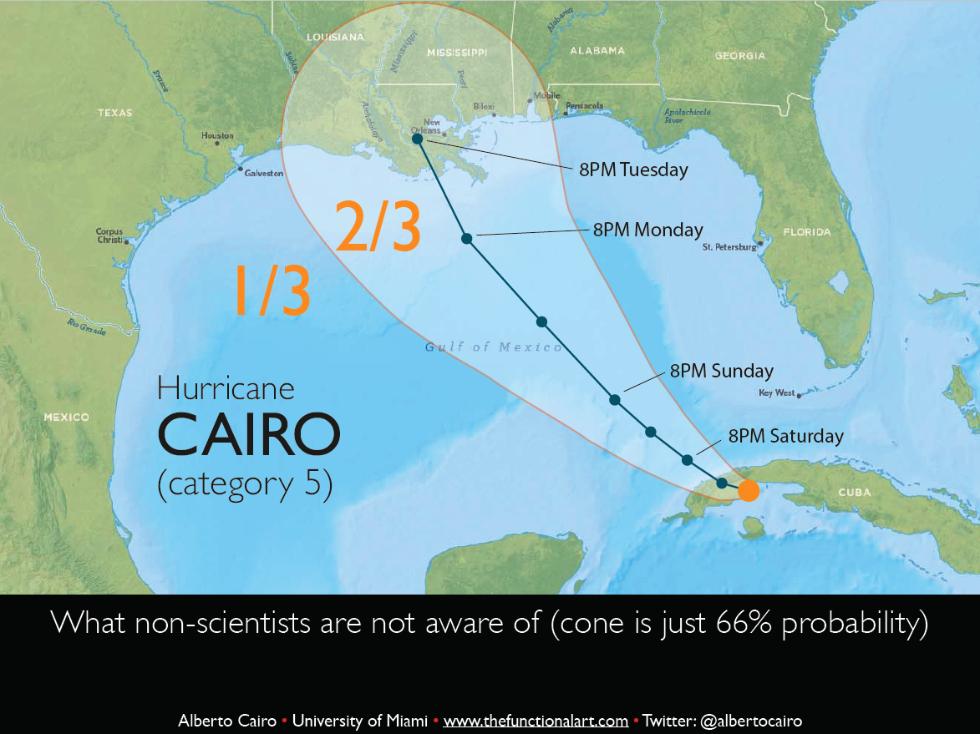
Graphical Integrity: What’s wrong?

Slide 39
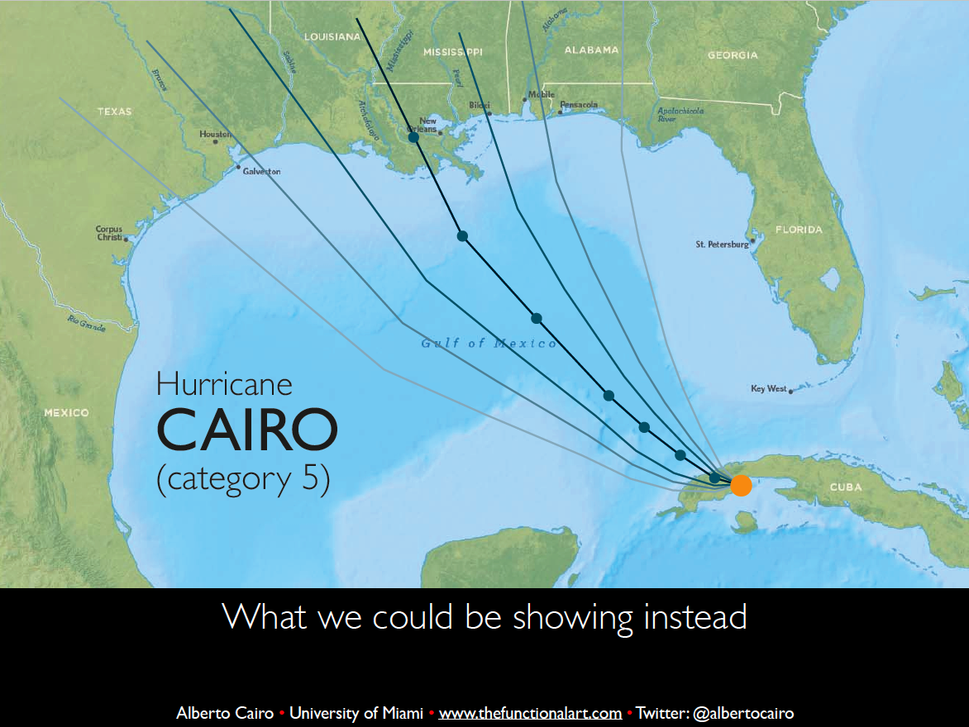
Graphical Integrity: What’s wrong?

Slide 40
Graphical Integrity: What’s wrong?
Lesson II: include uncertainty when possible

Slide 41
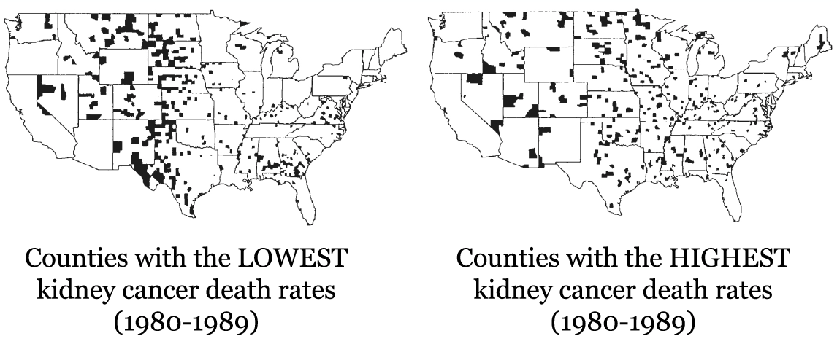
Graphical Integrity: What’s wrong?

Slide 42
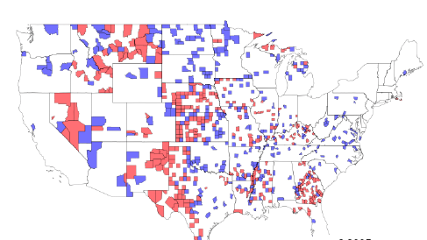
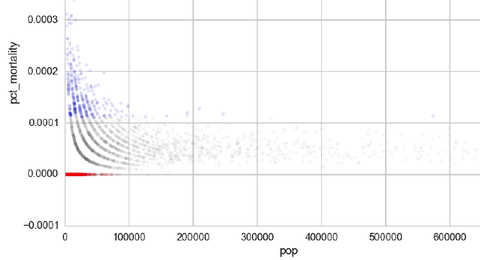
Graphical Integrity: What’s wrong?

Slide 43
Graphical Integrity: What’s wrong?
Lesson III: plot all the data

Slide 44
Agenda
EDA Refresher
Effective Visualization
Graphical Integrity
Scope
Displays
Sensible Design
Communication
Motivation
Key Considerations

Slide 45
Agenda
EDA Refresher
Effective Visualization
Graphical Integrity
Scope
Displays
Sensible Design
Communication
Motivation
Key Considerations

Slide 46
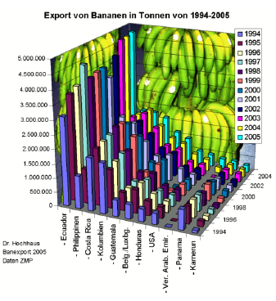
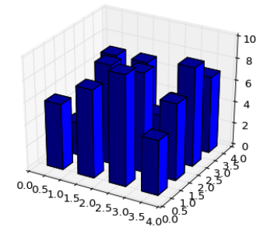
Scope: What’s wrong?

Slide 47
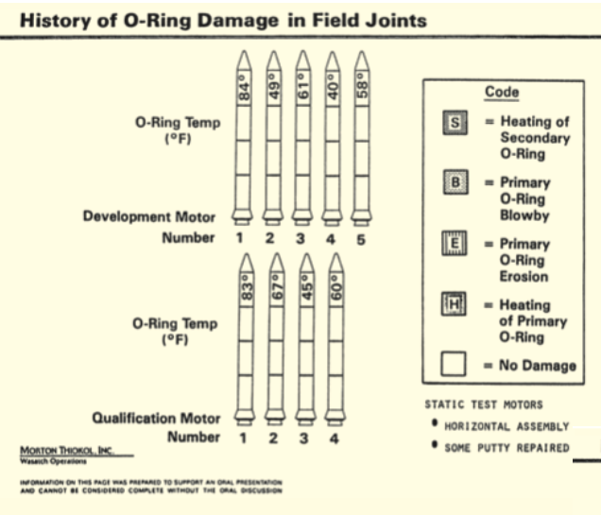
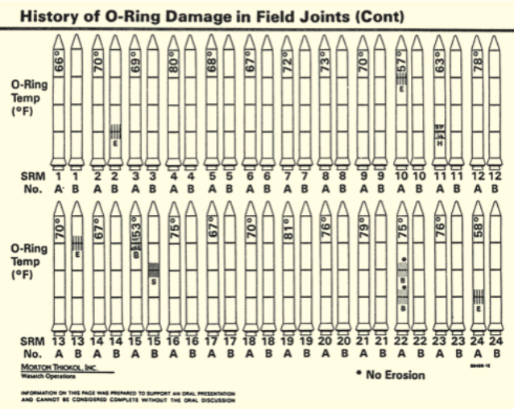
Scope: What’s wrong?
What’s wrong?

Slide 48
Scope
Lesson IV: keep it simple… enough

Slide 49
Scope
“You should have stayed with the soup question. The object of a question is to obtain information that matters only to us”
-- Sean Connery in Finding Forrester (movie)

Slide 50
Scope
Making plots is effectively providing an answer to an implicit question
You get to pick the way to express the answer
Ensure the answer doesn’t leave the viewer with uncertainty as to what it’s answering or the completeness of the answer
A good plot should invoke and inspire new questions

Slide 51
Agenda
EDA Refresher
Effective Visualization
Graphical Integrity
Scope
Displays
Sensible Design
Communication
Motivation
Key Considerations

Slide 52
Agenda
EDA Refresher
Effective Visualization
Graphical Integrity
Scope
Displays
Sensible Design
Communication
Motivation
Key Considerations

Slide 53
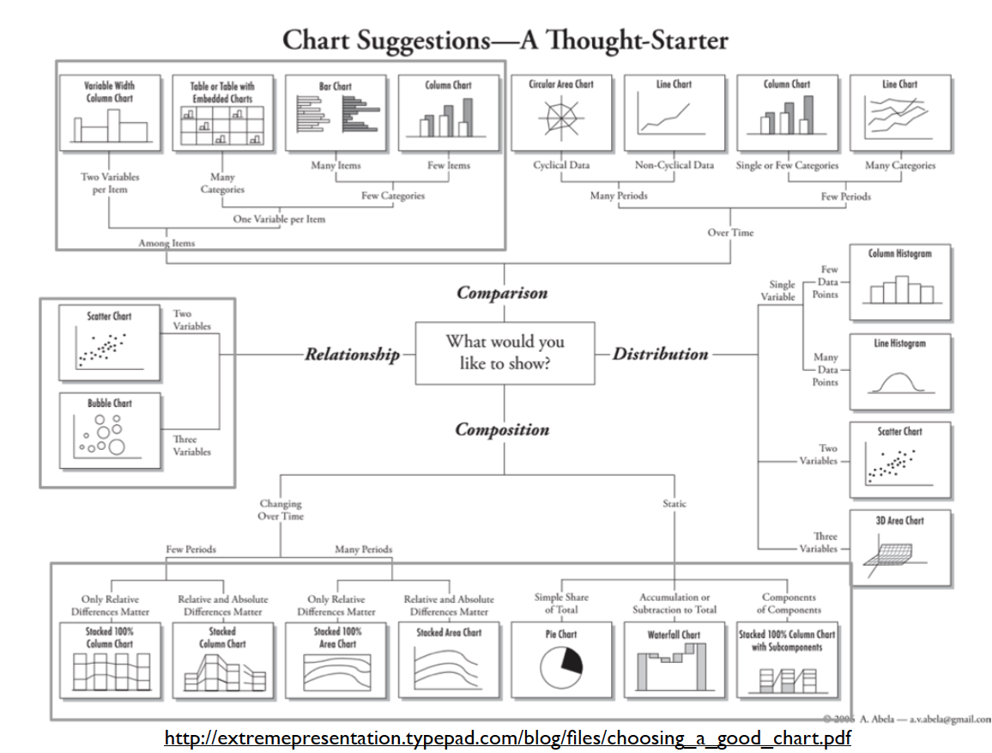
Displays

Slide 54
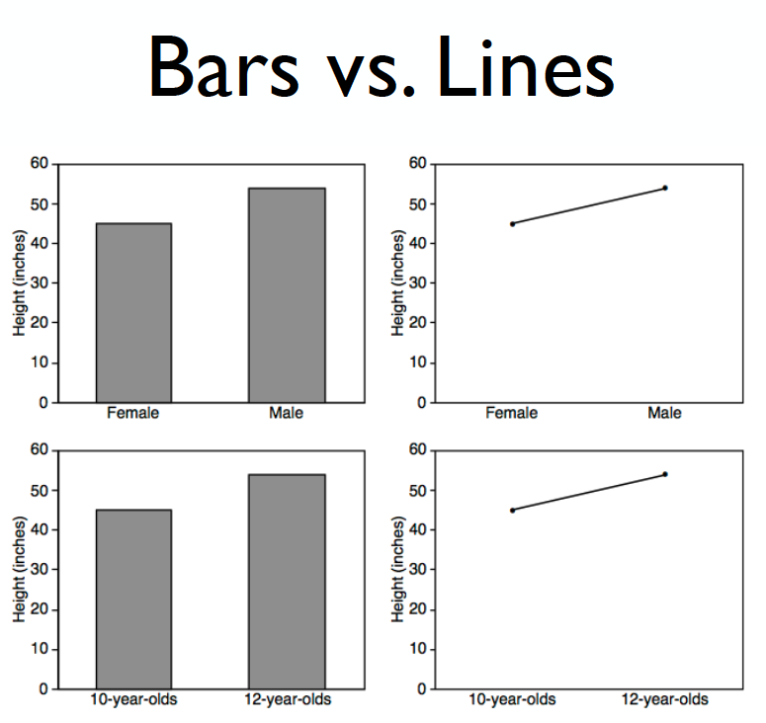
Displays: comparisons

Slide 55
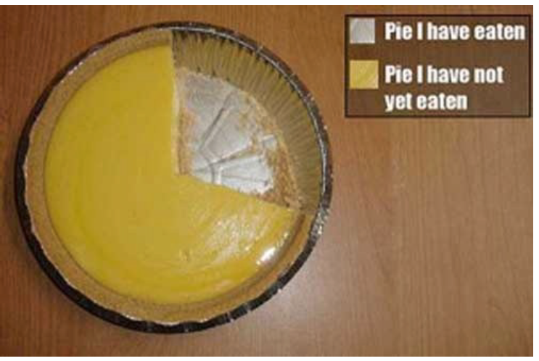
Displays: proportions

Slide 56
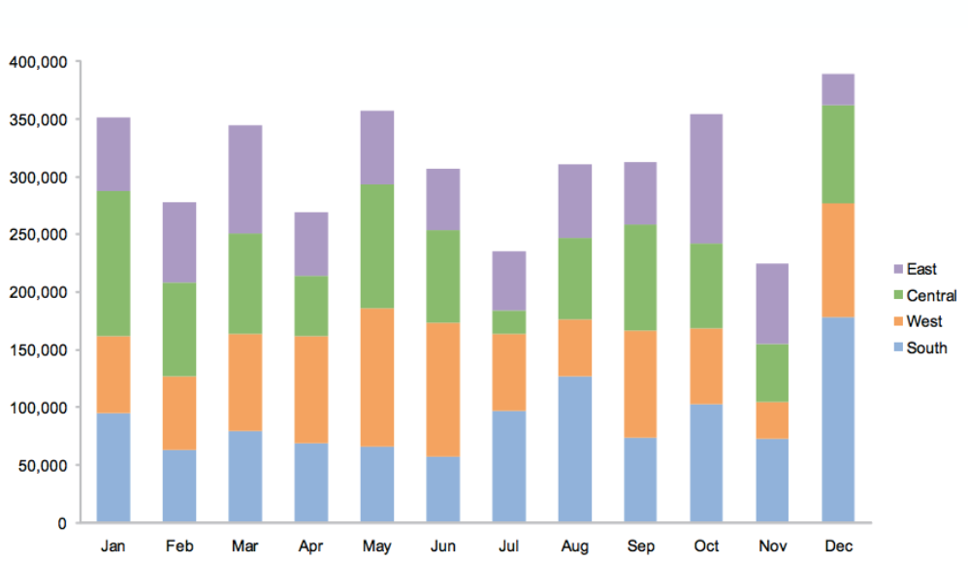
Displays: proportions

Slide 57
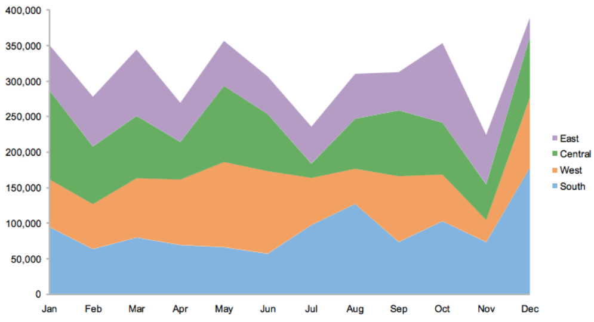
Displays: proportions

Slide 58
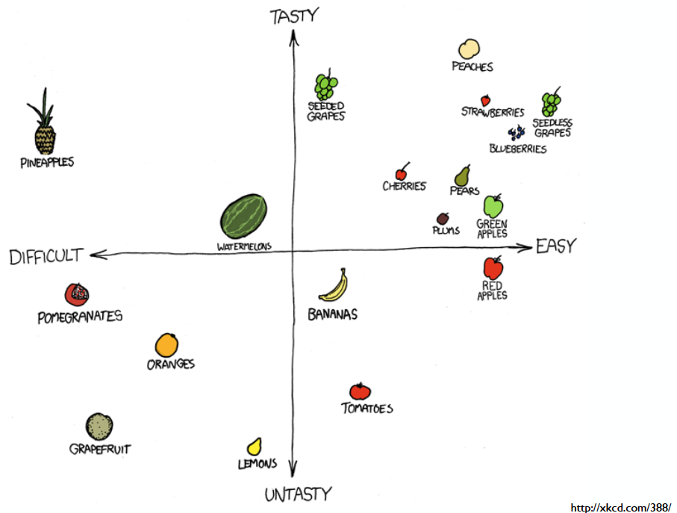
Displays: scatter plot

Slide 59
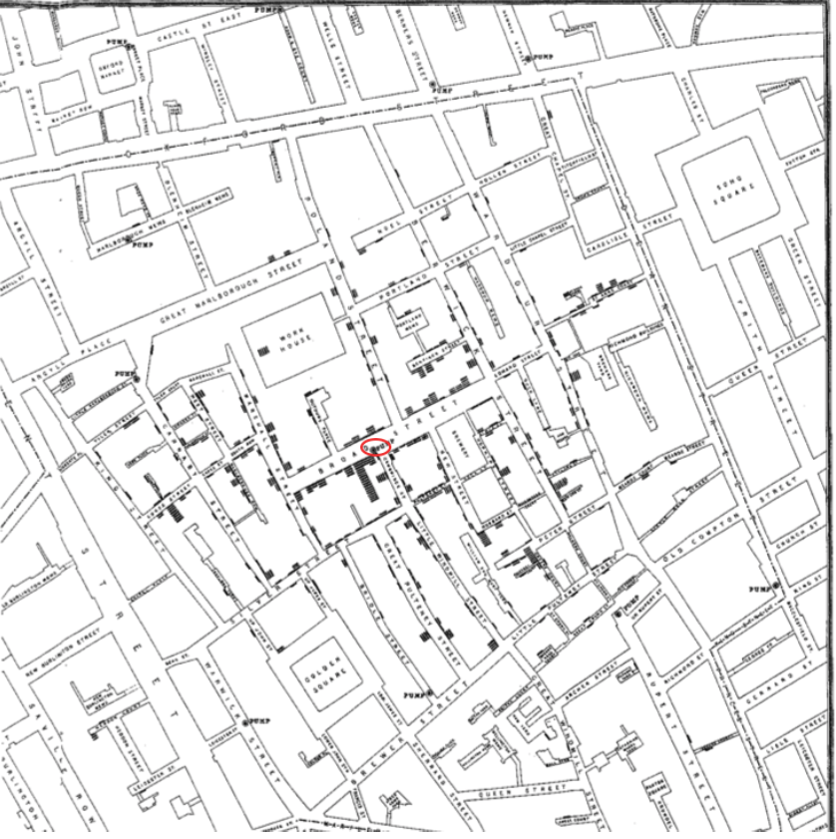
Displays: proportions
London Cholera Epidemic
-- Edward Tufte,
Visual and Statistical Thinking

Slide 60
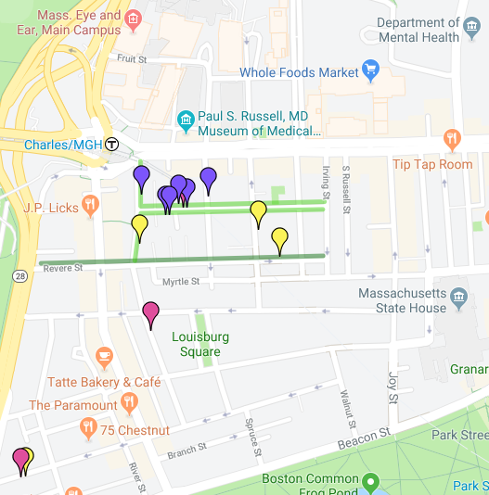
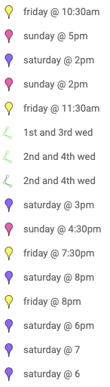
Displays: proportions

Slide 61
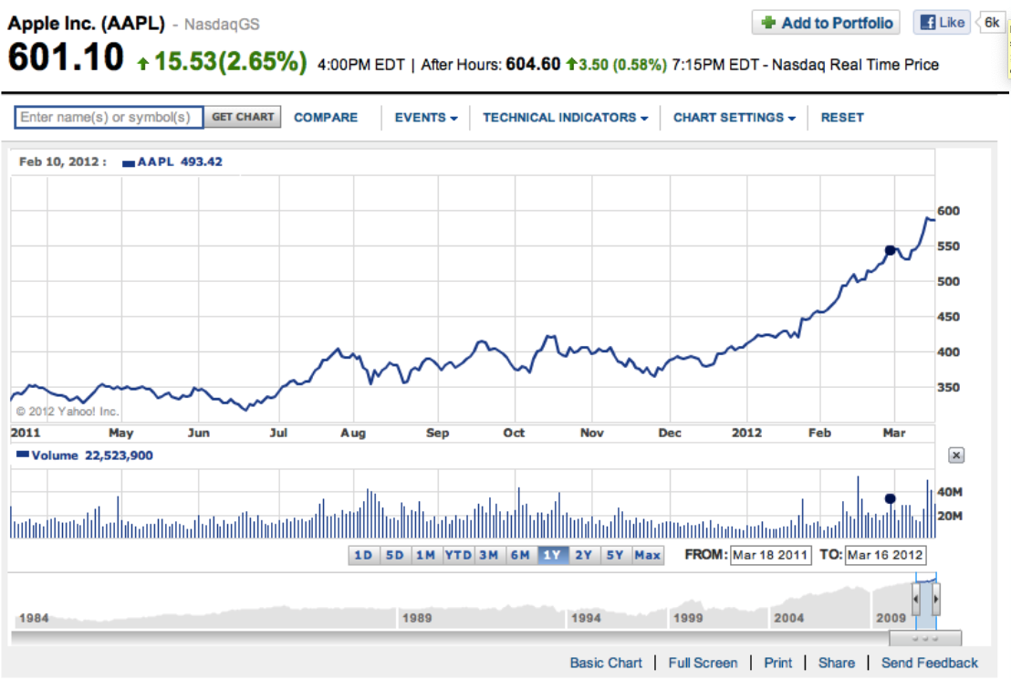
Displays: trends

Slide 62
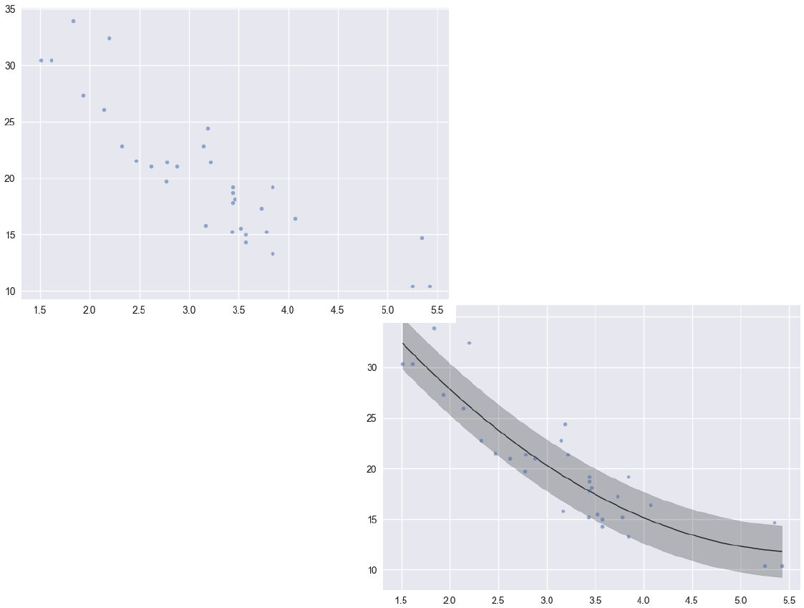
Displays: trends

Slide 63
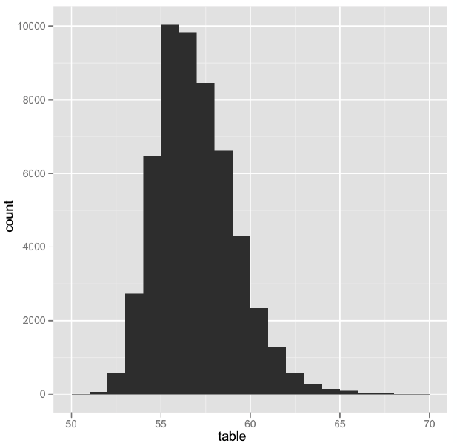
Displays: distributions

Slide 64
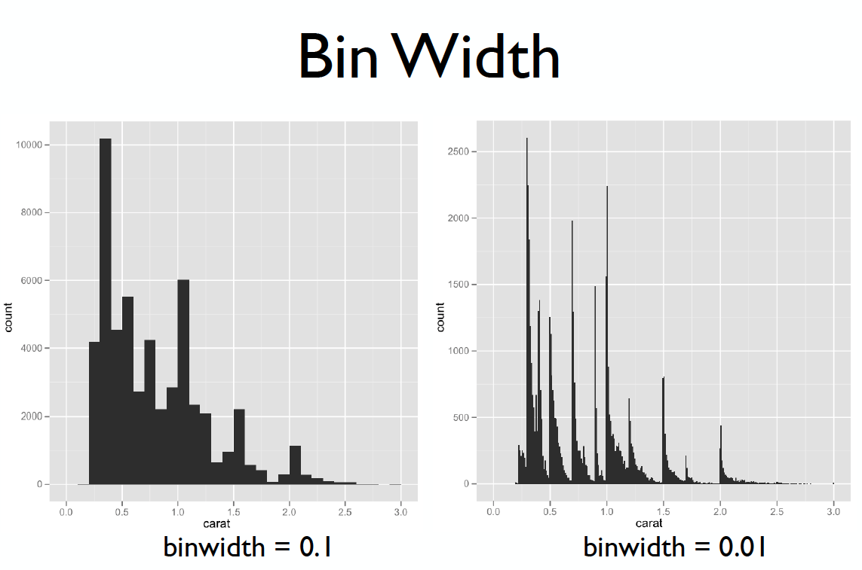
Displays: distributions

Slide 65
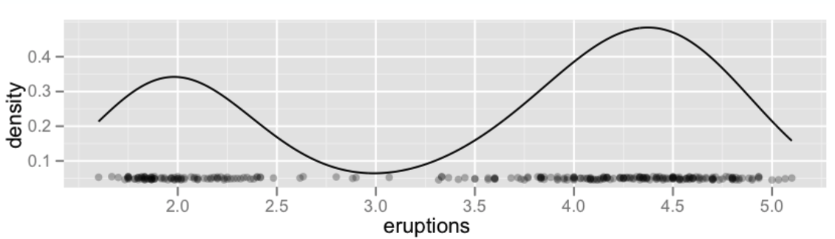
Displays: density plots

Slide 66
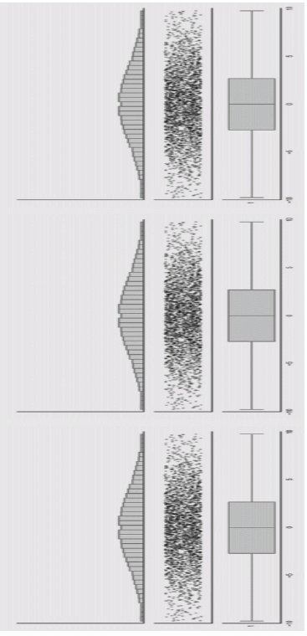
Displays: distributions
https://www.autodeskresearch.com/publications/samestats

Slide 67
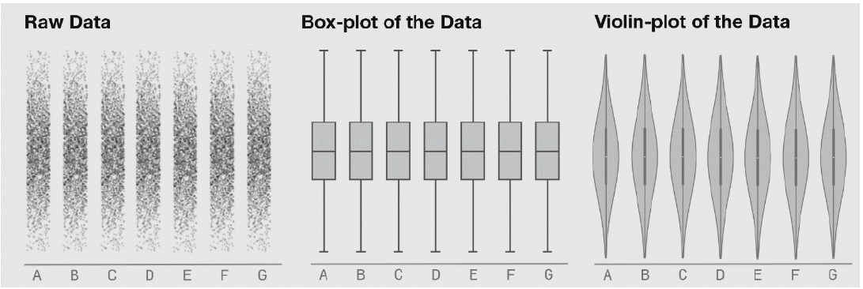
Displays: distributions

Slide 68
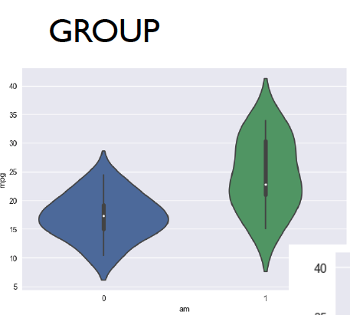
Displays: distributions

Slide 69
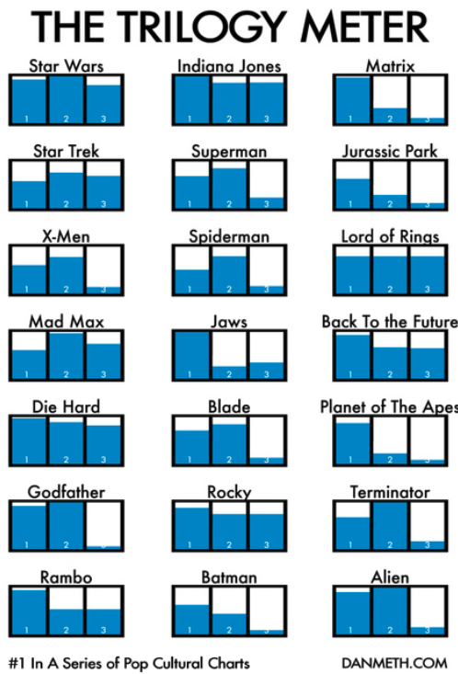
Displays: small multiples

Slide 70
Displays: scatter plot matrix

Slide 71
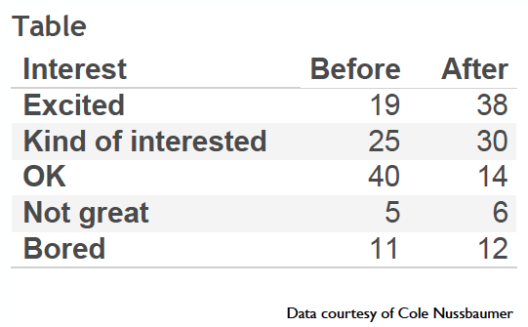
Break-out Discussion!
How do you feel about doing science?

Slide 72
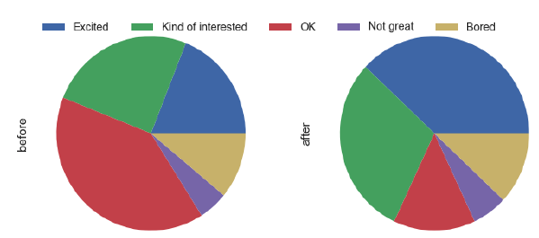
Displays: exercise feedback

Slide 73
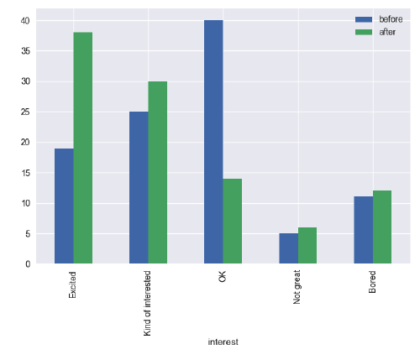
Displays: exercise feedback

Slide 74
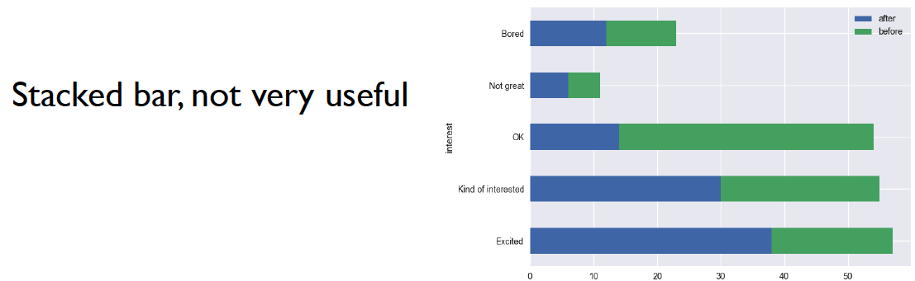
Displays: exercise feedback

Slide 75

Displays: exercise feedback

Slide 76

Displays: exercise feedback

Slide 77

Displays: exercise feedback

Slide 78

Displays: exercise feedback

Slide 79
Time for a game
🎉

Slide 80

Displays: perceptual effectiveness

Slide 81
Displays: perceptual effectiveness
4x

Slide 82

Displays: perceptual effectiveness

Slide 83
Displays: perceptual effectiveness
4x

Slide 84

Displays: perceptual effectiveness

Slide 85
Displays: perceptual effectiveness
4.5x

Slide 86

Displays: perceptual effectiveness

Slide 87
Displays: perceptual effectiveness
2x

Slide 88

Displays: perceptual effectiveness

Slide 89
Displays: perceptual effectiveness
4x

Slide 90

Displays: perceptual effectiveness

Slide 91

Displays: perceptual effectiveness

Slide 92

Displays: perceptual effectiveness

Slide 93

Displays: perceptual effectiveness

Slide 94
Agenda
EDA Refresher
Effective Visualization
Graphical Integrity
Scope
Displays
Sensible Design
Communication
Motivation
Key Considerations

Slide 95
Agenda
EDA Refresher
Effective Visualization
Graphical Integrity
Scope
Displays
Sensible Design
Communication
Motivation
Key Considerations

Slide 96

Sensible Design

Slide 97

Sensible Design

Slide 98

Sensible Design

Slide 99

Sensible Design: Color Gradients

Slide 100

Sensible Design: Color Gradients

Slide 101

Sensible Design: Color Gradients

Slide 102

Sensible Design: Color Gradients

Slide 103

Sensible Design: Color Gradients

Slide 104

Sensible Design: Color Gradients

Slide 105



Sensible Design: Color Pickers!
Great sites for selecting color schemes:
http://colorbrewer2.org
https://coolors.co/
Coolors.co

Slide 106
Sensible Design: Typography
How much do you trust this text?
How much do you trust this text?
How much do you trust this text?
How much do you trust this text?

Slide 107
Sensible Design: Beyond Data Science
The everyday items that are designed the best are the ones that we never have to think about how to use/interact with it.
Can you think of examples?
Highly recommended

Slide 108
Sensible Design: Beyond Data Science
Lesson V: design matters

Slide 109
Agenda
EDA Refresher
Effective Visualization
Graphical Integrity
Scope
Displays
Sensible Design
Communication
Motivation
Key Considerations

Slide 110
Agenda
EDA Refresher
Effective Visualization
Graphical Integrity
Scope
Displays
Sensible Design
Communication
Motivation
Key Considerations

Slide 111
Communication
Analyze (Exploratory)
Explore the data
Assess a situation
Determine how to proceed
Decide what to do
Communicate (Explanatory)
Present data and ideas
Explain and inform
Provide evidence and support
Influence and persuade

Slide 112


Slide 113

Communication

Slide 114


Slide 115
Agenda
EDA Refresher
Effective Visualization
Graphical Integrity
Scope
Displays
Sensible Design
Communication
Motivation
Key Considerations

Slide 116
Agenda
EDA Refresher
Effective Visualization
Graphical Integrity
Scope
Displays
Sensible Design
Communication
Motivation
Key Considerations

Slide 117
Communication
Key Considerations
Who is your audience
What questions are you answering?
Why should the audience care?
What are your major insights and surprises?
What change do you want to affect?

Slide 118
Communication
Don’t make them think!
The audience does not want to spend cognitive energy on dissecting and decoding your intended message.
Lead them through the major steps of your story.
Point out interesting key facts and insights using captions and annotations

Slide 119

Communication

Slide 120

Communication

Slide 121

Communication

Slide 122

Communication

Slide 123
Final Takeaways
How you choose to display your data greatly influences how people interpret the data
Humans are visual, emotional creations; make graphs that don’t make others feel confused, insulted, etc.
Your graphs should illicit good feelings and effectively convey your narrative

Slide 124
Suggested Python Packages
Matplotlib
Seaborn
plotly
ggplot

Slide 125
Further Good Examples
https://www.nytimes.com/ tends to have incredibly high-quality visualizations that convey information seamlessly
https://www.reddit.com/r/dataisbeautiful/
fivethirtyeight.com

Slide 126



Slide 127

https://projects.fivethirtyeight.com/2016-election-forecast/

Slide 128

https://projects.fivethirtyeight.com/2020-election-forecast/

Slide 129

https://projects.fivethirtyeight.com/2020-election-forecast/

Slide 130
Exercise time!

